Slide 1
Introduction to Functioning Ecosystems

Slide 2
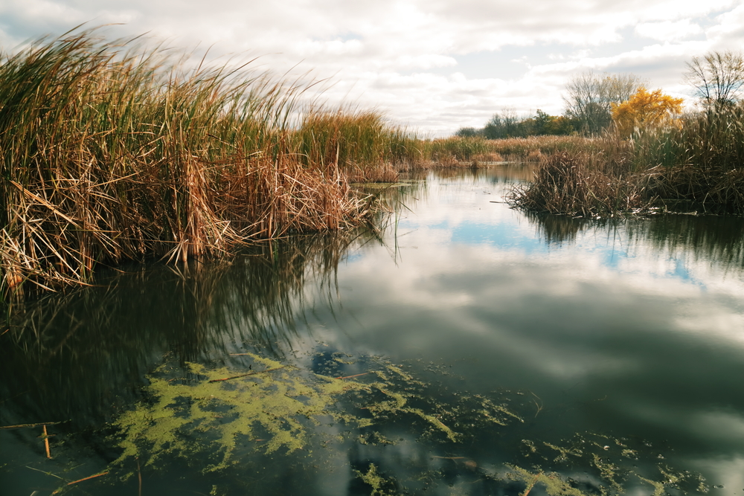
Welcome to this Introduction to Functioning Ecosystems lesson
“An ecosystem is a complex in which habitat, plants and animals are considered as one interesting unit, the materials and energy of one passing in and out of the others”.
—Woodbury, 1954.

Slide 3
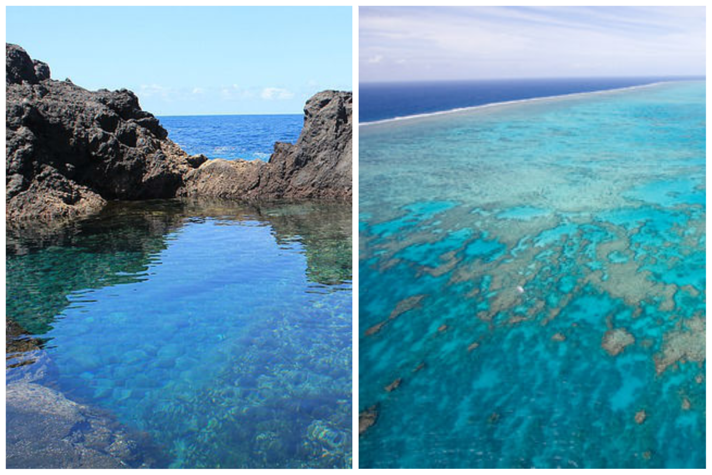
In this lesson you will learn about what constitutes an ecosystem, and how energy is able to move throughout components of it.
By the end of this lesson, you should be able to:
Define an ecosystem.
Describe the levels and living and non-living components of an ecosystem.
Outline the trophic levels of an ecosystem.
Explain how energy is able to move between trophic levels in an ecosystem.

Slide 4
The biotic factors of an ecosystem can be divided into a series of levels.
These levels are an organism, population, community, which then ultimately forms an ecosystem.
An organism in an ecosystem is the autotrophs and heterotrophs we have been talking about.
A population is a group of organisms of the same species that live in the same area.
A community includes populations of different species living together in the same area. The organism, population and community then all create an ecosystem.
Remember, all biotic levels interact with and are influenced by abiotic factors—such as water, soil climate and temperature.

Slide 5
Multiple ecosystems can be found in a specific geographical area called a biome.
A biome is a group of ecosystems that have a particular set of adaptations to a specific environment, along with the environment they inhabit. They are considered the world’s major ecosystems, classified according to the predominant vegetation and characterised by adaptations of organisms to that particular environment.
Biomes can be categorised into two broad categories (with multiple types of biomes found in each). These are terrestrial and aquatic biomes.
Terrestrial biomes include tundra, tropical rainforest, desert and temperate forests. Aquatic biomes include freshwater wetlands, open ocean, coral reefs and estuaries.
Remember, biomes and ecosystems are not the same thing. An ecosystem is the interaction of living and non-living things in an environment. A biome is a specific geographic area notable for the species living there. A biome can be made up of many ecosystems (i.e. an aquatic biome can contain ecosystems such as coral reefs and kelp forests).

Slide 6
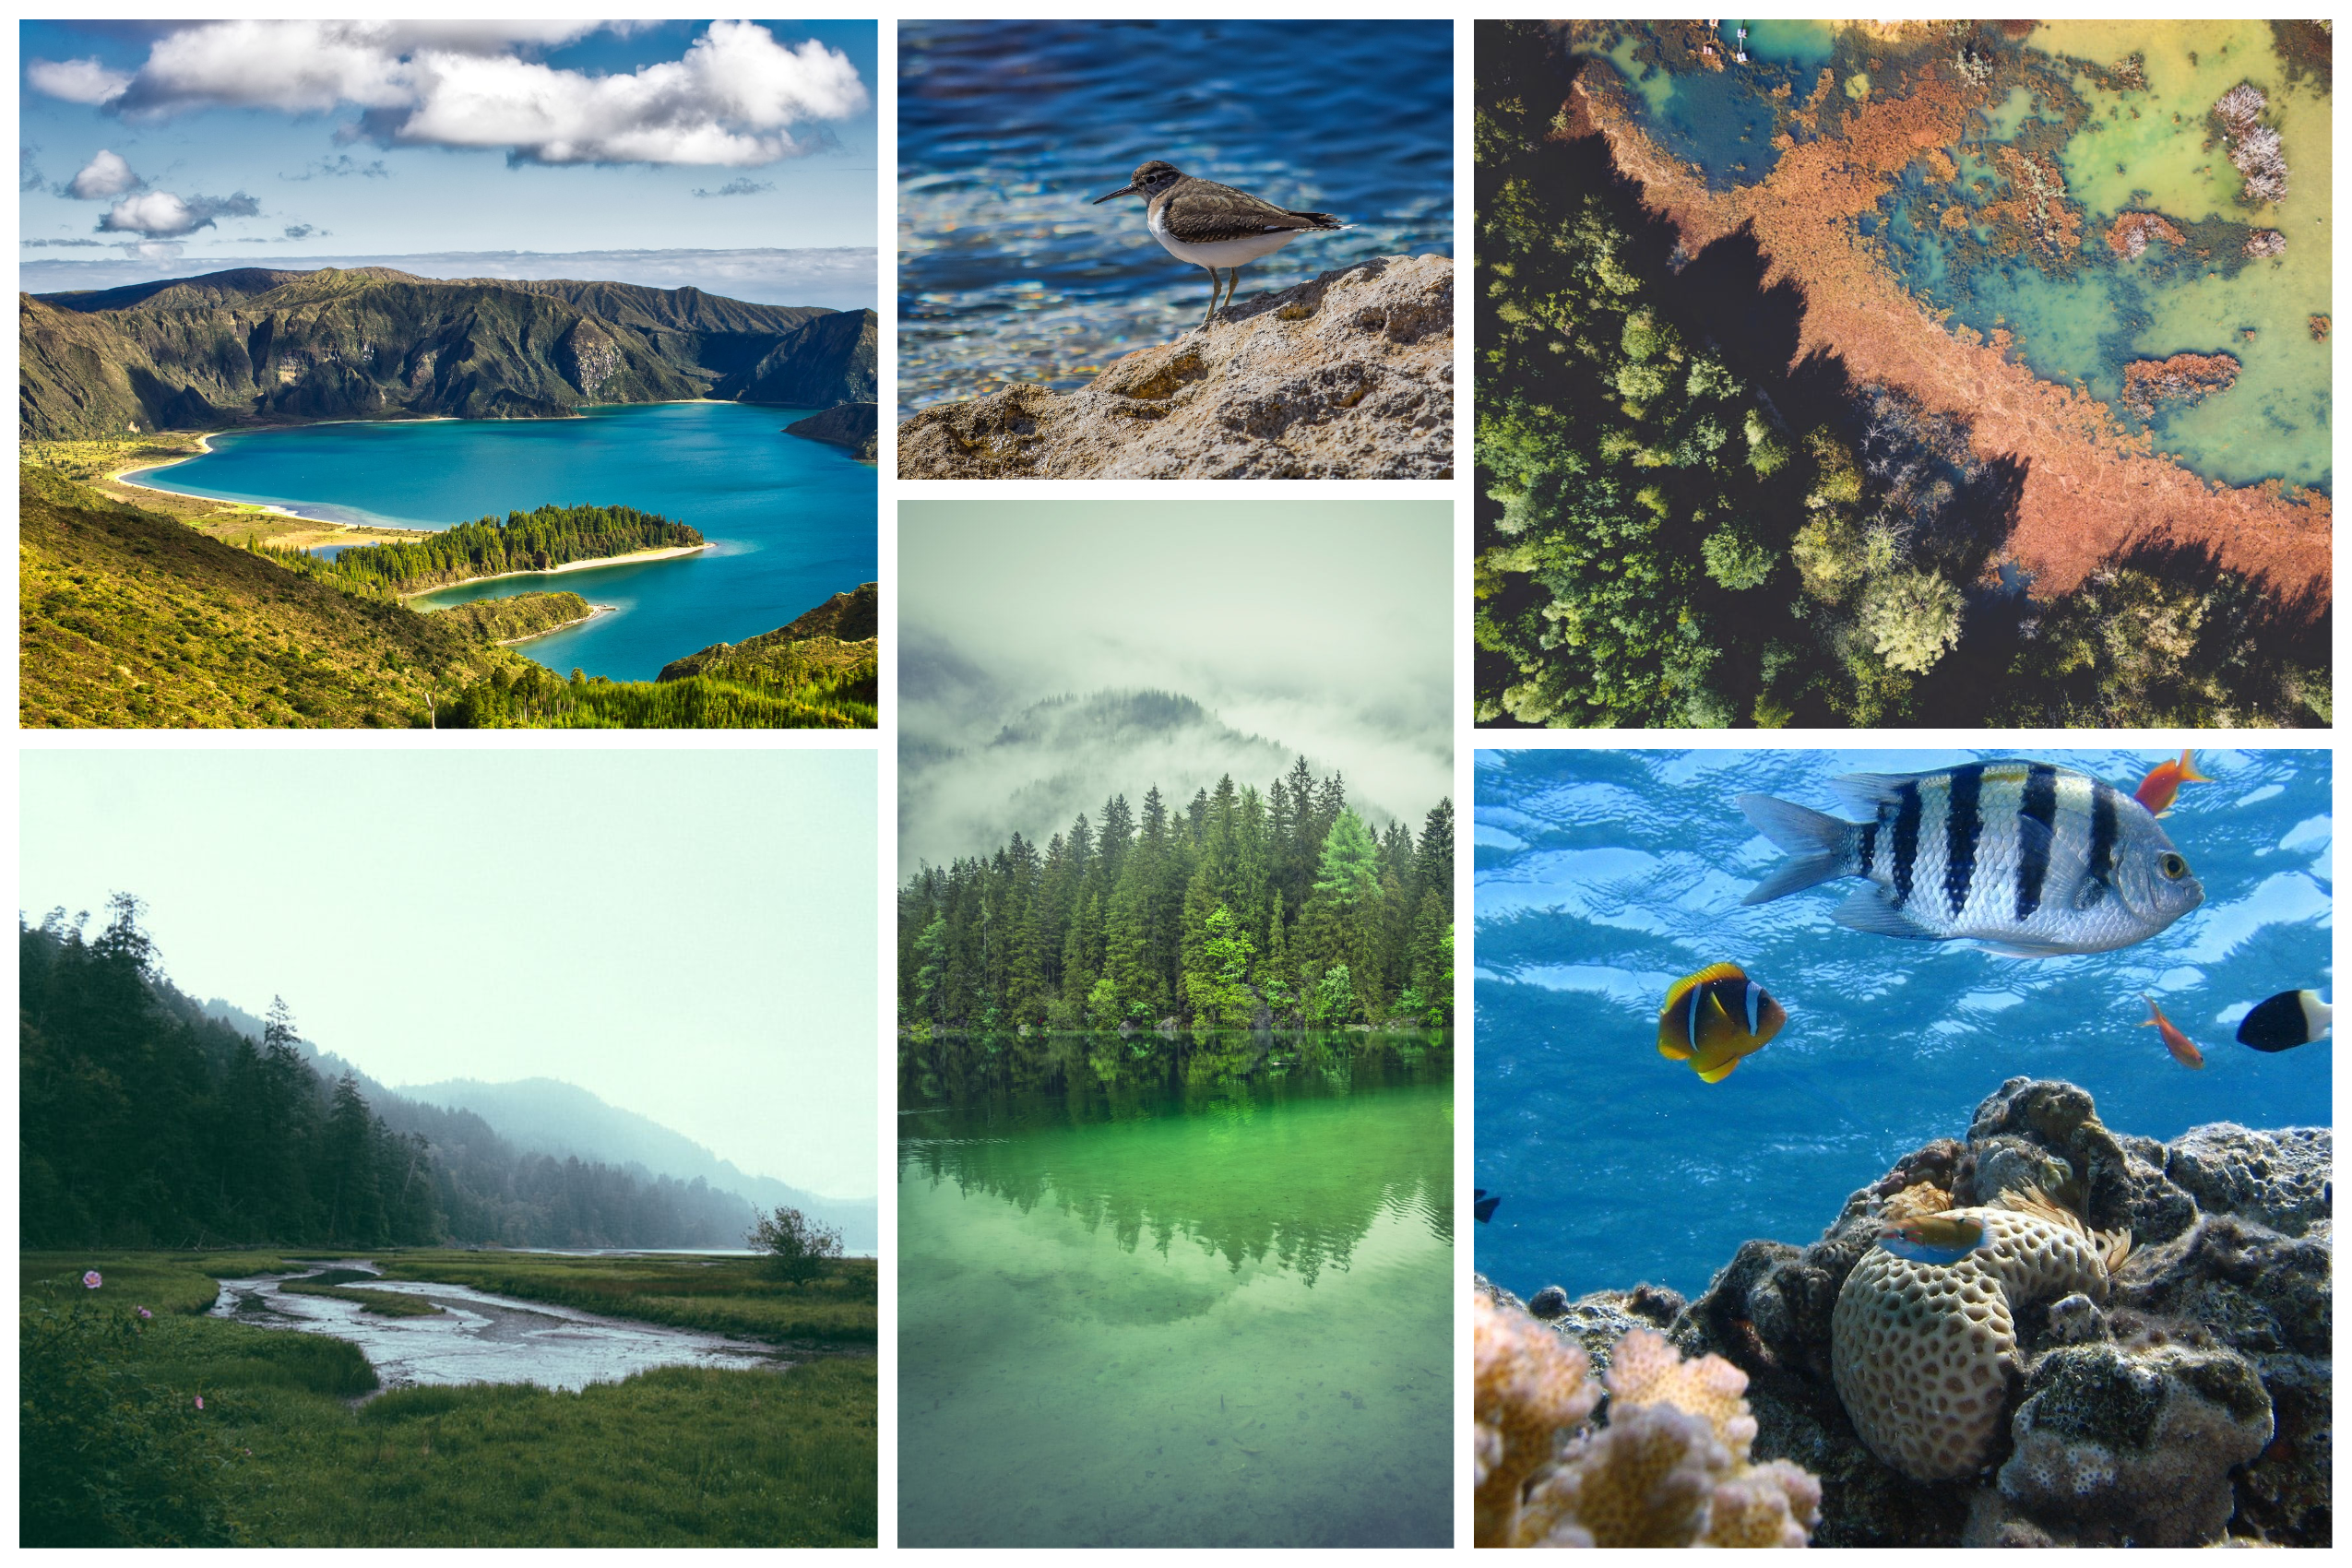

Slide 7
Energy fuels life. Whether it’s that emergency chocolate bar at 3pm when your brain isn’t working or your dog practically inhaling its food; all living things require energy in order to stay alive.
All living things on Earth require energy to power their cellular processes. The sun provides most of the energy used on Earth (i.e. green plants use sunlight to undergo photosynthesis). As discussed in the previous information section, living organisms can obtain energy in various methods—i.e. photosynthesis, consuming autotrophs, heterotrophs or both. The different methods by which various organisms obtain energy can result in a flow of energy throughout a specific ecosystem.
We can show the flow of energy in an ecosystem in one of two ways—a food chain or food web. Essentially, a food chain is a series of organisms that eat one another, with producers at the base (the energy they capture from light or chemicals sustains all the other organisms in the ecosystem community). Food chains can also be thought of as a series of organisms in which energy is transferred to one another.

Slide 8
The group of organisms that occupy the same level in a food chain can be divided into a trophic level.
A trophic level is an organism’s position (or feeding level) in a food chain, web. It illustrates how many consumption steps separate an organism from the food chain’s original energy source, such as sunlight. There are five trophic levels as shown in the table below.

Slide 9
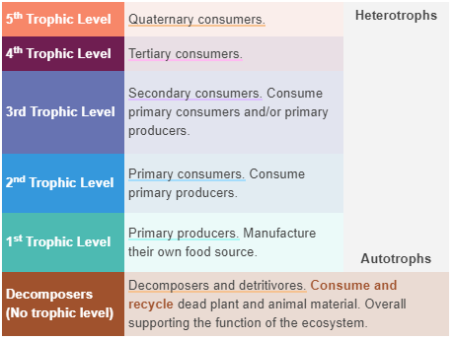

Slide 10
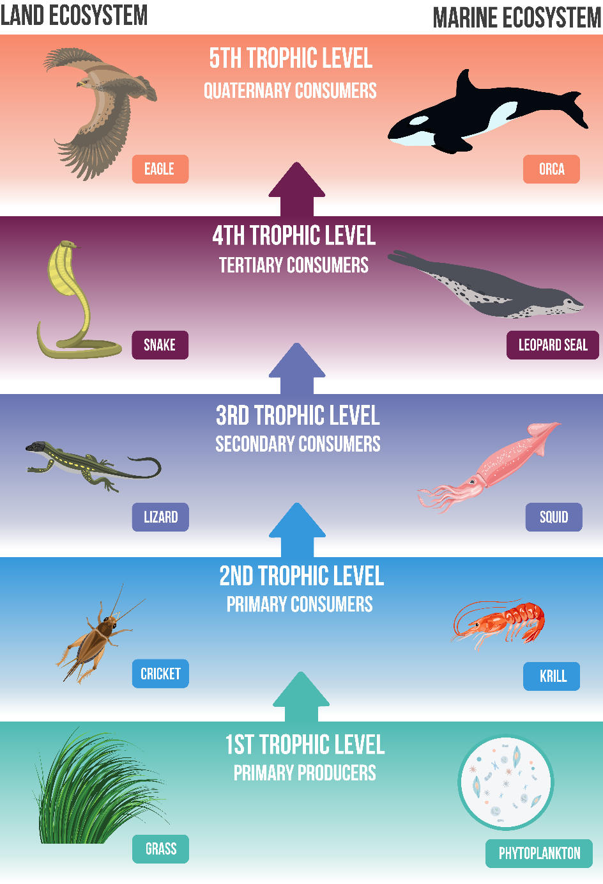
Below is a diagram illustrating how different consumers and producers are separated into specific trophic levels in a land and marine ecosystem food chain.

Slide 11
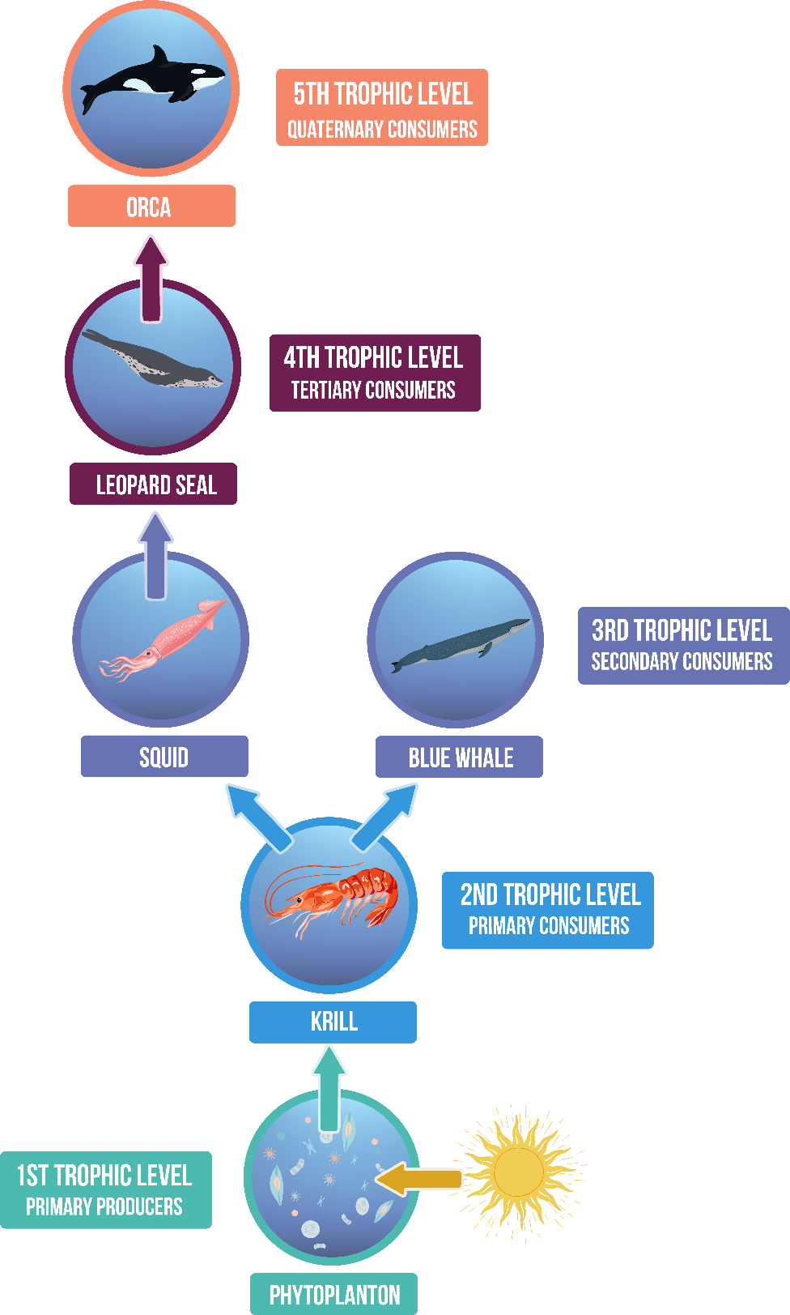
While food chains are useful at depicting the flow of energy in an ecosystem, in most ecosystems energy flow is much more complicated than a linear chain.
In these cases, we use a food web to represent the feeding interactions between trophic levels. An example food web is shown below.

Slide 12
Whenever energy enters a specific trophic level, some of it is stored as biomass.
Biomass refers to the total mass of living things in a given area. This is the energy that’s available to the next trophic level (as only energy stored as biomass can be consumed).
As you go up the trophic levels, the total biomass of organisms tends to decrease. This is because only 10% of the energy that’s stored as biomass in one trophic level ends up as stored biomass in the next trophic level. The rest of the energy (90%) is lost as waste and heat energy.
As a result, each succeeding trophic level supports a smaller number of organisms (or it has less biomass).

Slide 13
